Slide 1

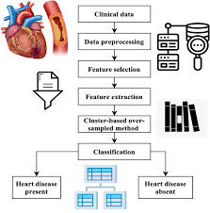

Capstone Project1
Heart Disease Prediction Model
Team Members
T120100112: Amol Kulkarni
T120100116: Abhishek
T120100118: Harshitha Balaji
T120100119: Rahul R Udhand
T120100120: S Vani Reddy
T120100121: Nandini R

Slide 2
Table of Contents
Problem Statement
Overview of the Project
Data generation & Loading
Data Exploration & Understanding
Exploratory Data Analysis
Data Preprocessing & Feature Engineering
Model Building & Training
Model Evaluation & Performance Analysis
Stream API Deployment
Docker Deployment
Conclusion

Slide 3

Problem Statement & Clinical Motivation
Global Health Crisis
Diagnostic Challenges
17.5 million deaths annually from cardiovascular diseases worldwide (WHO, 2025)
Manual diagnosis is time-intensive, subjective, and prone to human error in risk assessment
Data Complexity
Multiple interconnected risk factors create complex patterns difficult to interpret manually
Our motivation centres on leveraging machine learning to integrate multiple clinical risk factors, providing reliable early prediction that could save countless lives through timely medical intervention.

Slide 4

Project Overview
Cardiovascular disease remains the leading cause of death globally, claiming approximately 17.9 million lives each year. Early detection through advanced predictive modelling represents a critical breakthrough in preventive healthcare.
This comprehensive project develops an intelligent machine learning system that analyses clinical data patterns to predict heart disease risk with remarkable accuracy, enabling healthcare professionals to intervene before it's too late.

Slide 5

Data Generation & Loading Strategy
Data Source
Kaggle's Heart Failure Prediction dataset curated by Fedesoriano et al., containing comprehensive clinical records from multiple healthcare institutions.
Technical Implementation
Data loading orchestrated using Python's robust ecosystem: Pandas for data manipulation, NumPy for numerical computations, ensuring efficient processing workflows.
400
12+
Patient Records
Clinical Features
Comprehensive clinical histories
Age, blood pressure, cholesterol, ECG results

Slide 6

Data Exploration & Statistical Understanding
01
02
Statistical Profiling
Visual Data Mining
Comprehensive analysis of means, medians, standard deviations, and missing value patterns across all clinical features
Advanced visualisations including histograms, box plots, and correlation heatmaps to uncover hidden data relationships
03
Clinical Insights
Key discovery: Age and cholesterol levels demonstrate strongest correlation with heart disease presence
Missing data challenges were addressed through sophisticated imputation techniques, preserving dataset integrity whilst maintaining the clinical validity of our predictive model.

Slide 7








Exploratory Data Analysis Deep Dive
Class Distribution
Feature Relationships
Analysed balance between heart disease positive and negative cases to prevent model bias
Pairplots and scatter matrices revealed complex interdependencies between clinical variables
Feature Importance
Outlier Detection
Mutual information scores provided preliminary assessment of predictive power across variables
Systematic identification and treatment of statistical anomalies to ensure model reliability

Slide 8
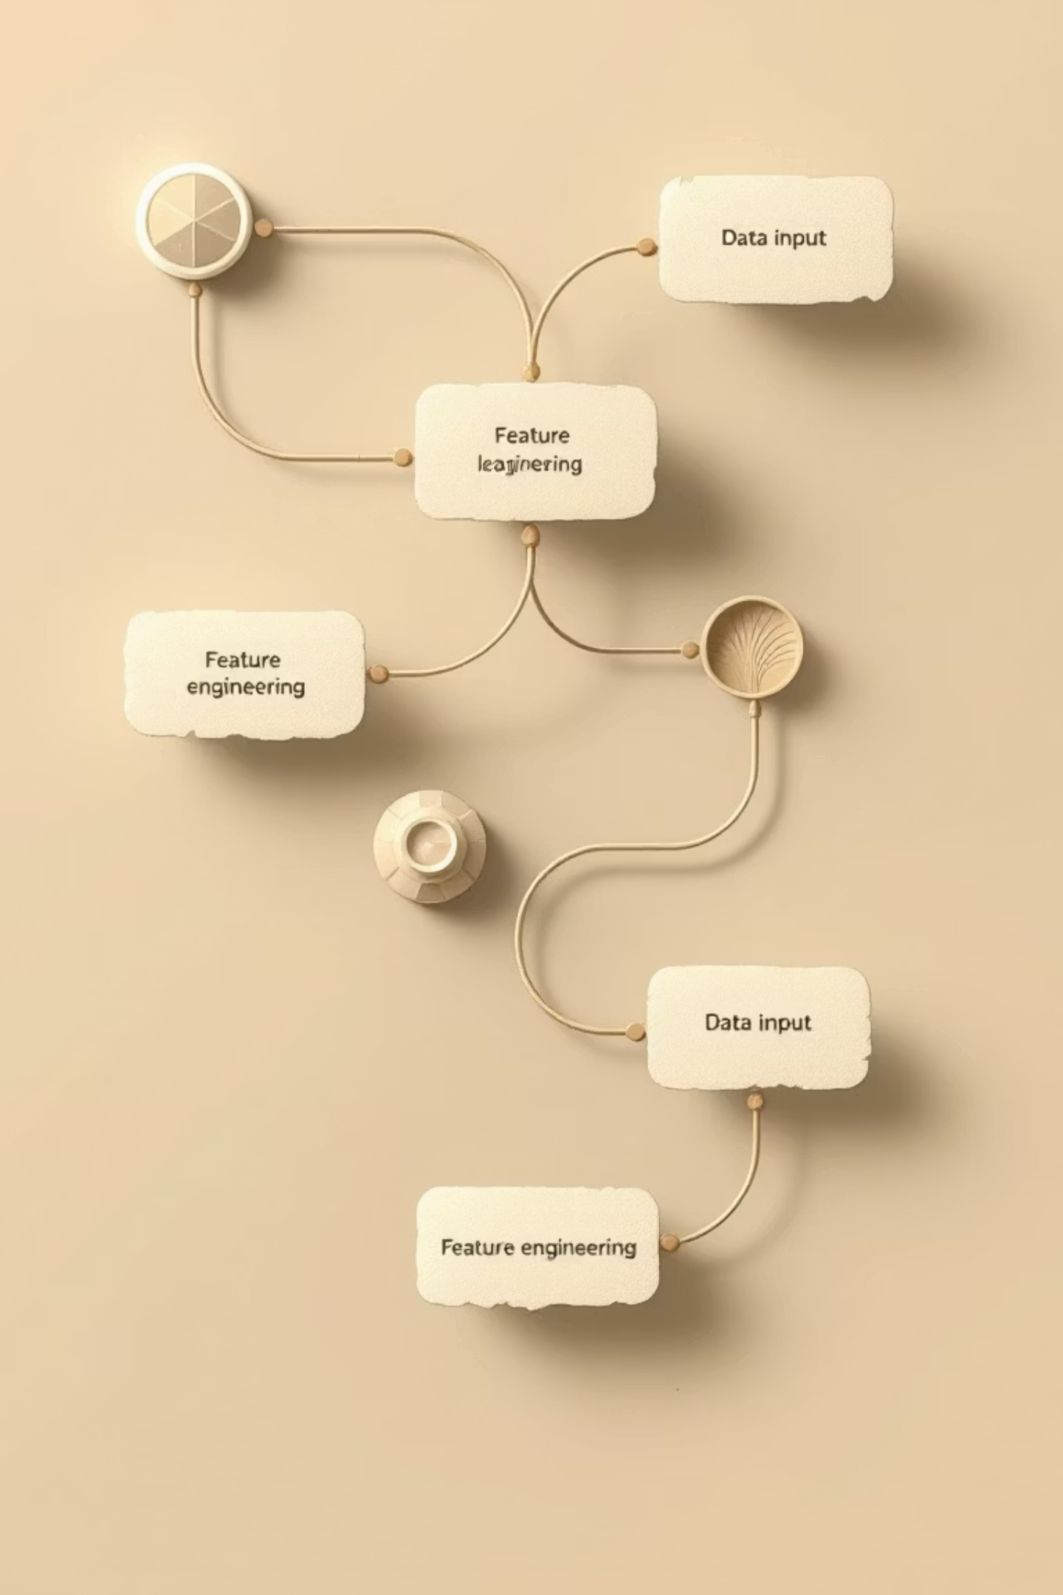




Data Preprocessing & Feature Engineering Excellence
Data Cleansing
Systematic removal of duplicates, handling of missing values through advanced imputation strategies
Categorical Encoding
One-hot encoding applied to categorical variables such as chest pain types for optimal model compatibility
Feature Scaling
StandardScaler implementation ensures algorithms sensitive to magnitude perform optimally
Feature Creation
Engineered new variables including BMI categories and age groups to enhance predictive capability

Slide 9

Model Building & Advanced Training Methodology
Algorithm Portfolio
Logistic Regression: Linear probabilistic approach
Random Forest: Ensemble decision tree methodology
Support Vector Machine: High-dimensional classification
Decision Tree: Gradient boosting optimisation
Training Strategy
Implemented 70-30 training-testing split with stratified sampling to maintain class distribution integrity. GridSearchCV employed for systematic hyperparameter optimisation across all algorithms.
79%
Best Accuracy
Random Forest champion

Slide 10
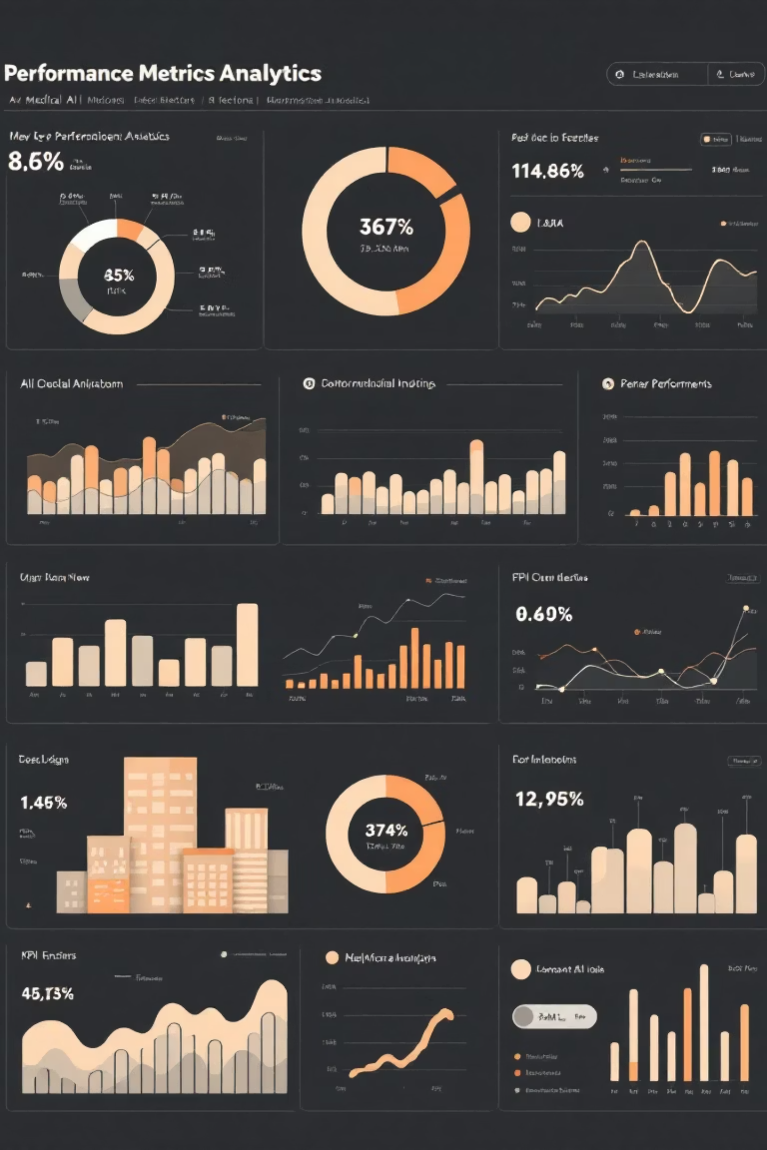




Model Evaluation & Comprehensive Performance Analysis
Performance Metrics
Comprehensive evaluation using Accuracy, Precision, Recall, F1-Score, and ROC-AUC for holistic model assessment
Error Analysis
Detailed confusion matrix visualisation enabling thorough analysis of false positives and false negatives
Model Stability
Cross-validation techniques confirm robust generalisation capability and consistent performance across data subsets
Explainability
SHAP values implementation provides transparent feature impact interpretation for clinical decision support

Slide 11





Production Deployment: Streamlit API & Docker Containerisation
Real-Time Processing
RESTful API Development
System accepts patient clinical data inputs and returns comprehensive risk probability assessments instantaneously
Streamlit-powered API enables real-time heart disease risk prediction with intuitive user interface
Healthcare Integration
Container Deployment
Architecture designed for seamless integration with existing hospital information systems and mobile health applications
Docker containerisation ensures seamless deployment, scalability, and consistent performance across diverse environments

Slide 12



Conclusion & Strategic Future Roadmap
Project Success
Delivered highly accurate, clinically interpretable heart disease prediction model with 79% accuracy
Clinical Impact
Enables early diagnosis capability, potentially reducing mortality rates and healthcare system costs
Future Enhancement Vision
Integration of real-time wearable sensor data for continuous monitoring
Expansion of dataset diversity across global populations and demographics
Clinical deployment partnerships to assist healthcare professionals worldwide
This groundbreaking model represents a significant step towards predictive healthcare, transforming how we approach cardiovascular disease prevention and patient care globally.

Slide 13
Any Queries ???

